Slide 1
Introduction to Machine Learning: linear modelling
Goldsmiths University

Slide 2
Predictive models and descriptive models
Predictive: make sense to separate the data into training and testing. We want to see if the model is reliable when asked to make prediction on unseen data.
Descriptive: we may just want to get information of our data using the model as a tool to describe the structure of the data compared to a target. We can work directly on the entire dataset without splitting.

Slide 3
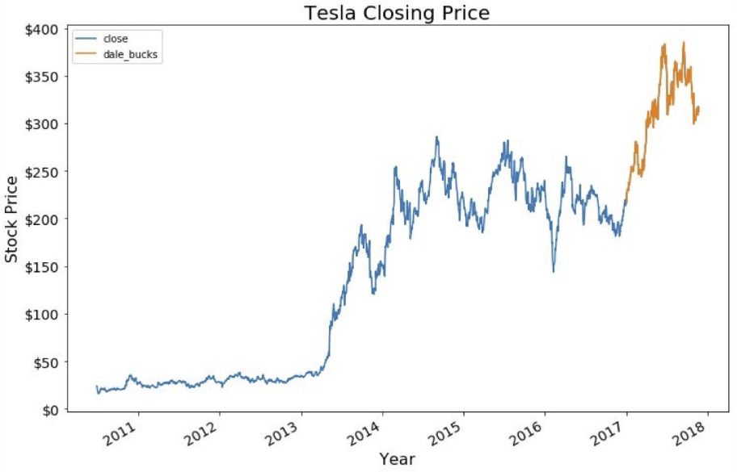
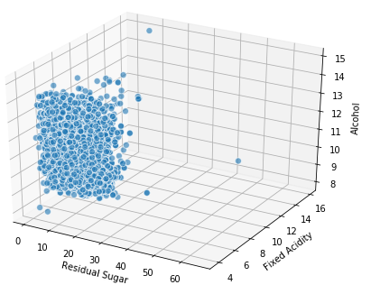
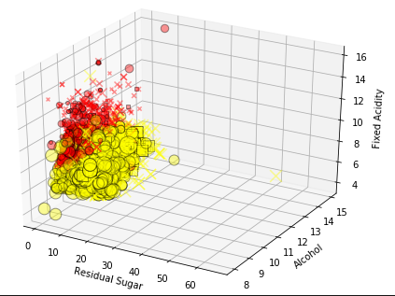
Shapes
X.shape
(1250 , 1)
X.shape
(1250 , 2)
X.shape
(1250 , 100)
1250 observations
1 feature
One dimensional data
1250 observations
2 features
Bi-dimensional data
1250 observations
100 features
100th-dimensional data
Only up to 3 features on a graph)

Slide 4
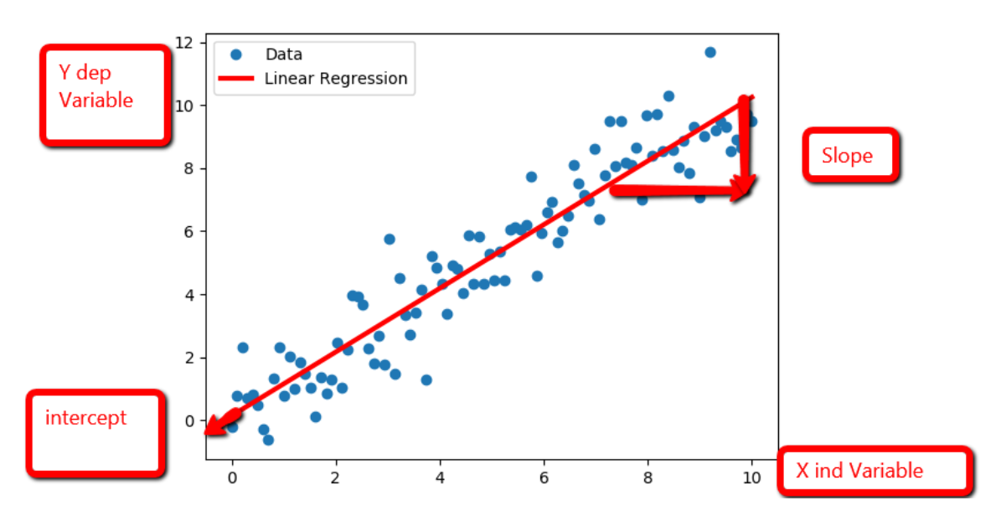
Linear Regression: REGRESSION MODEL prediction of Continuous values.
Linear models make a prediction using a linear function of the input features.
The model tries to learn the line of best fit for the data.
We want to find the slope and intercept of the line.
y = Dependent variable, target, label...
X = the features vector (the length of this vector is the number of features(columns) we have.
if we have 1 feature and 1 target
New Point: X = [5.85]
Prediction: y = 6

Slide 5
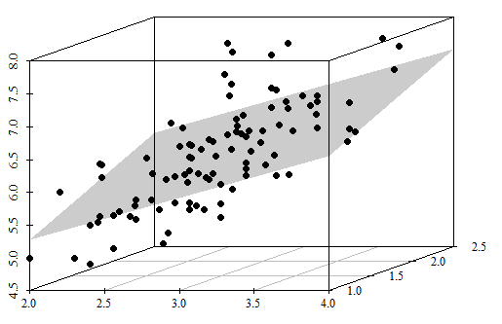
Linear Regression
Linear models make a prediction using a linear function of the input features.
if we have 2 features and 1 target, the model tries to learn the plane of best fit for the data.
Linear Models work also for high dimensional data but we cannot visualise the hyperplane of best fit in a graph
if we have 2 features and 1 target

Slide 6






Linear classification in higher dimensions
If the data is linearly separable in 2D space
What happens in 1D ?
What happens in 3D ?
$$x_{2}$$
$$x_{2}$$
$$x_{2}$$
$$x_{3}$$
$$x_{1}$$
$$x_{1}$$
A point in 1D $→$ line in 2D $→$ plane in 3D $→$ hyperplane in 3+D
Notes:
If separable in 2D -> separable in 3D+, but may not separate in lower dimensions…

Slide 7
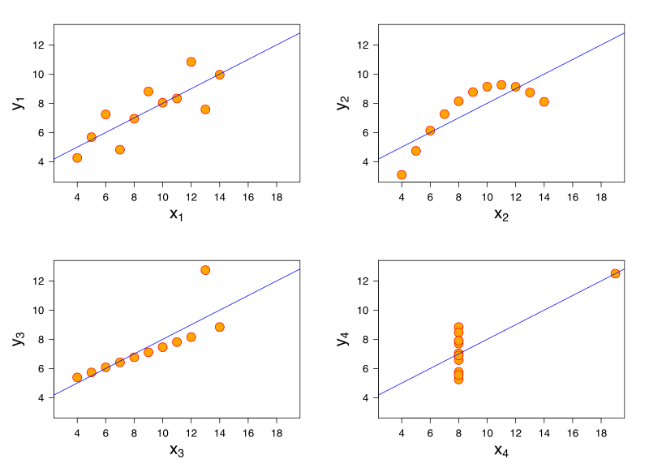
How to describe a dataset with a single line?
4 Possible datasets.
1= ideal
2 = non linear relation of the feature and the target
3 and 4 = large error for a set of data and small for another subset, and distribution of feature values are somehow skewed.
y = target
X = 1 single feature

Slide 8
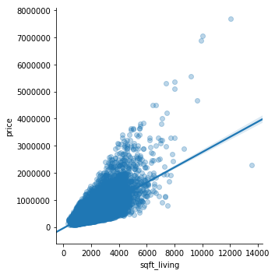
How to calculate the line of best fit.
Left: we got a line that fit our training data. X = sqft_living y = price.
When there is a single input variable, the method is referred to as a simple linear regression. In simple linear regression we can use statistics on the training data to estimate the coefficients required by the model to make predictions on new data.
The line for a simple linear regression model can be written as:
y = b0 + b1 * x (equation of the line)
Where b0 and b1 are the coefficients we estimate from the training data. (b0 intercept , b1 slope)

Slide 9
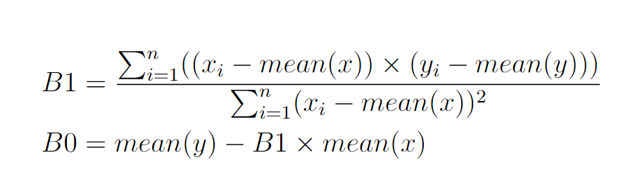
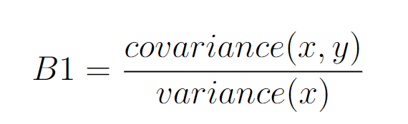
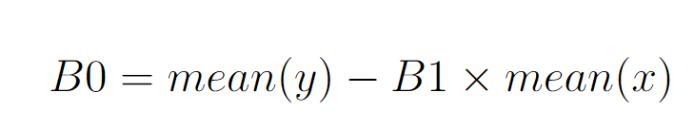
Simple linear regression
In Seaborn, Matplotlib, pandas etc, when we plot pair plot we can visualise the best fit line immediately (the graph uses this formula).
Slope
Intercept

Slide 10


How to find the best fit line (hyperplane) when we have more features?
Prediction formula. x are the features and , w[i] and b are the parameters that the model tries to learn, and y(hat) is the prediction the model makes.
notice that for a dataset of a single feature the formula becomes equivalent to the equation of the line that we had before.
If we used arbitrary values for w[i] and b , with this formula for each point in our data we can calculate a y(hat) prediction value. But we want those w[i] and b to be calculated by the model so that the prediction are closer to optimal prediction value.
What is the optimal prediction value?

Slide 11
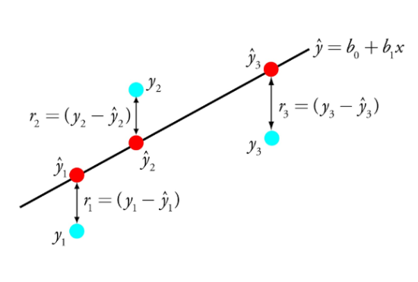
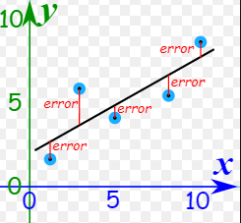
Optimal prediction value.
Since we have the true values from our training data (It is supervised learning) we can calculate the difference between the prediction made by the model and the true values that we have from the training dataset.
We want the sum of all the errors closer to zero as possible

Slide 12
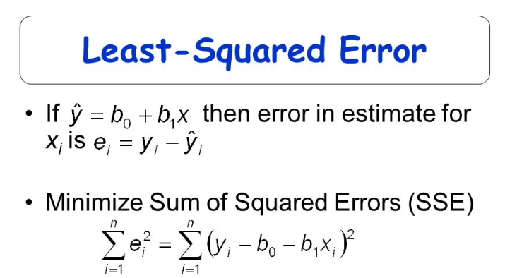
How to get the weights to minimise the sum of the errors
e_{i} == “the residual”

Slide 13
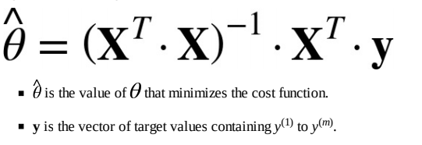

Normal Equation (and derivations...)
To find the value of θ (weights) that minimizes the cost function, there is a closed-form solution — in other words, a mathematical equation that gives the result directly. This is called the Normal Equation
https://scikit-learn.org/stable/modules/generated/sklearn.linear_model.LinearRegression.html

Slide 14
Normal Equation pros-cons
The Normal Equation computes the inverse of the design matrix (X) multiplied by it’s transpose, as in the previous formula. The computational complexity of inverting such a matrix is as if you double the number of features, you multiply the computation time by roughly 8.
This equation is linear with regards to the number of instances in the training set so it handles large training sets efficiently, provided they can fit in memory. Also, once you have trained your Linear Regression model (using the Normal Equation..), predictions are very fast: the computational complexity is linear with regards to both the number of instances you want to make predictions on and the number of features. In other words, making predictions on twice as many instances (or twice as many features) will just take roughly twice as much time.
The Normal Equation gets very slow when the number of features grows large (e.g., 100,000).
Some useful notes on the Normal equation: http://anwarruff.com/normal-equation/

Slide 15


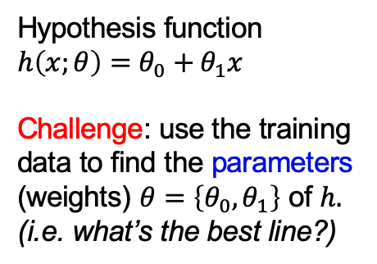


Find the best line
$$y$$
Hypothesis function $$h\left(x;θ\right)=θ_{0}+θ_{1}x$$
Challenge: use the training data to find the parameters (weights) $θ=\left\{θ_{0},θ_{1}\right\}$ of $h.$
(i.e. what’s the best line?)
$$175 350 525 700$$
$$0 32.5 65 97.5 130$$
$$x$$

Slide 16


Find the best line
$$y$$
Iterative Solution:
Start with a (random) line
Measure error or loss between line and data
$$price \left(£ks\right)$$
$$175 350 525 700$$
$$0 32.5 65 97.5 130$$
$$x$$
Living $area \left(m^{2}\right)$

Slide 17
Find the best line
$$y$$
Iterative Solution:
Start with a (random) line
Measure error or loss between line and data
Move line to try and lower the loss
$$175 350 525 700$$
$$0 32.5 65 97.5 130$$
$$x$$

Slide 18
Find the best line
$$y$$
Iterative Solution:
Start with a (random) line
Measure error or loss between line and data
Move line to try and lower the loss
Loop until best line found (loss minimised)
$$175 350 525 700$$
$$0 32.5 65 97.5 130$$
$$x$$

Slide 19
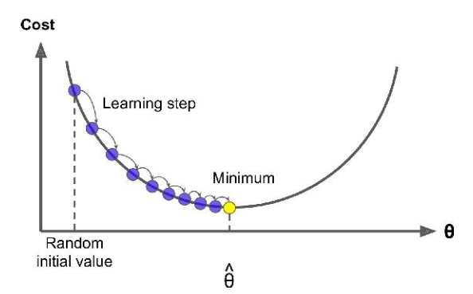
2) Gradient Descent
Where there are a large number of features, or too many training instances to fit in memory.
https://scikit-learn.org/stable/modules/sgd.html
We want to find the weights (slopes and intercept) that minimises the error
We can adjust the weights with little step moving toward the value that minimises the error
We need to know the direction to make these steps
Likely the derivative of the error function can give us the direction to move (and how large the step should be in that direction)
On the left is the plot of a potential simple error function

Slide 20
2) Stochastic Gradient Descent
Gradient Descent is the process of minimizing a function following the slope or gradient of that function. In machine learning, we can use a technique that evaluates and updates the coefficients every iteration called stochastic gradient descent to minimize the error of a model on our training data. The way this optimization algorithm works is that each training instance is shown to the model one at a time. The model makes a prediction for a training instance, the error is calculated and the model is updated in order to reduce the error for the next prediction. This process is repeated for a x number of iterations. This procedure can be used to find the set of coefficients in a model that result in the smallest error for the model on the training data. Each iteration, the coefficients (b) are updated using the equation:
b = b - learning rate * error * x
notice that error * x is the partial derivative for x of the error function
learning rate is a parameter that we can set to increase the size of our steps when we walk along the error function to get closer to the minimum. A high learning rate can produce a faster model in training but we can risk to overshoot the target

Slide 21
Considerations
Linear model assumes linearity. (In contrast to, say, KNN which doesn't assume anything of your data.) That means that if you have a relation of features and targets that is not linear you need to find a way to solve it. (maybe x^2...)
On the other hand if you have many features things change. In high dimension a linear model can overfit the data as well as a KNN.
Linear model assumes independence of the features. If there is a correlation this might lead to high variance in the coefficients, which can lead to an unstable (overfitting) model.
Heteroscedasticity - the idea that you have large error for a set of data and small for another subset
Violation of normality - your features are somehow skewed.
in KNN the training was at the same time of prediction. Here training is separated from prediction. We first train the model and then we make prediction. This is a parametric model (the model learns some parameters during training and then uses those parameters during prediction) In linear model (and also neural network) those parameters are called weights.
Tradeoff between model complexity and predictive error

Slide 22
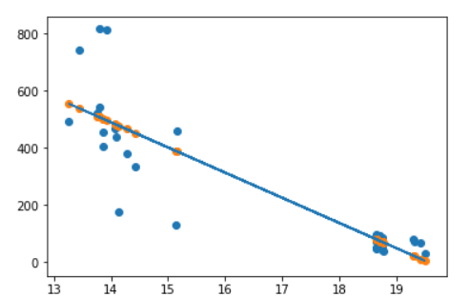
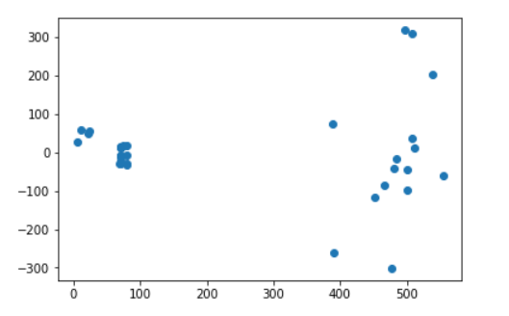
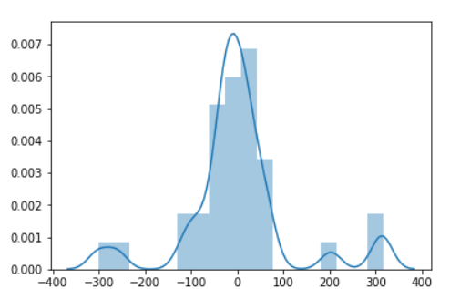
Evaluate the model visually
Residuals = y(hat) - y(true)
Number of sales
scatter
price
Ideally the best line should be a curve
Maybe the data should be divided into 2 separated problem (sales of beers in boxes of 24 and sales of beers in boxes of 6)
distribution
The first should be a horizontal line around 0 and the second more a bell shape
Notes:
Useful notes on residual plots: https://www.qualtrics.com/support/stats-iq/analyses/regression-guides/interpreting-residual-plots-improve-regression/

Slide 23

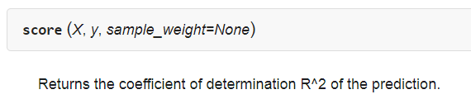
Evaluate a Linear Regression Model
We don’t have parameters that we can change in Scikit Learn Linear regression
But we can change the number of features, the type of features or introduce new features (features engineering)
When we evaluate linear regression it is more like comparing two (or more) possible models implementations
https://scikit-learn.org/stable/modules/generated/sklearn.metrics.r2_score.html
Inputs: true target , predictions
Inputs: X_test , y_test
For LR this returns the r2_score

Slide 24
R2_score
R squared (R2) is a statistical measure of how close the data are to the fitted regression line. It is also known as the coefficient of determination, or the coefficient of multiple determination for multiple regression.
R2 is the percentage of the response variable variation that is explained by a linear model. Or:
R2 = Explained variation / Total variation
R2 is typically between 0 and 1 (however, it can be negative)
R2=0 indicates that the model explains none of the variability of the response data around its mean.
R2=1 indicates that the model explains all the variability of the response data around its mean.
R2 is useful to compare to models rather than as an accuracy metrics for one regressor

Slide 25
Extra
There are parametric version of Linear Regression that allow to make the model smoother. Lasso Regression and Ridge Regression are two examples.
https://scikit-learn.org/stable/modules/linear_model.html
Another useful tutorial on lasso anrd ridge: https://scienceloft.com/technical/understanding-lasso-and-ridge-regression/

